Slide 1
Instrumental Music Information
for 2023

Slide 2
Instrumental Music Program Selection
Very limited positions are available due to our school allocation. Thus a long-term commitment is required as these positions a very highly sort after by other students and families.
• Year Two: students for a Beginner’s String Program starting in Year 3
• Year Three: Band Program starting in Year 4. Students learning a woodwind, brass or percussion instrument

Slide 3
Please note:
Under Education Queensland’s Policy, children who take up a place in the Beginner’s Strings Program starting in Year 3 will not be eligible to be offered a place in the Band Program.
Therefore, should a child be particularly keen to play a concert band instrument, but be offered a place in the Strings Program in Year Three, you may choose to forego entry into the Strings Program to give them the chance of an offer into the Concert Band Program, starting in Year Four.
(NB: Please note whilst there is a good chance the student will be subsequently offered a place in the Band Program, there is no guarantee.)

Slide 4
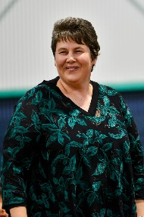
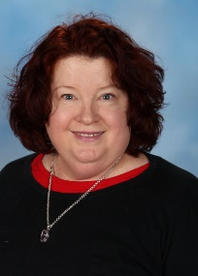
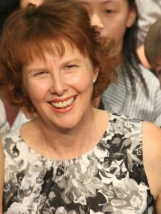
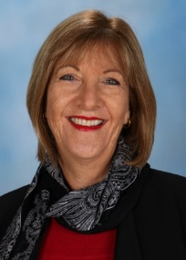
Music Staff (anticip[ated)
Mrs Robyn Forshaw (rfors2@eq.edu.au)
Instrumental Music Teacher (Brass)
Ms Helen Low (hlowe1@eq.edu.au)
Instrumental Music Teacher (Woodwind and Percussion)
Ms Penny Williams (pwill8@eq.edu.au)
Instrumental Music Teacher (Strings)
School Co-Ordination
Mrs Dorene Carter (dcar3@eq.edu.au) Classroom Music Teacher
Mrs Stoyko, kstoy1@eq.edu.au Deputy Principal and Music Line Manager

Slide 5
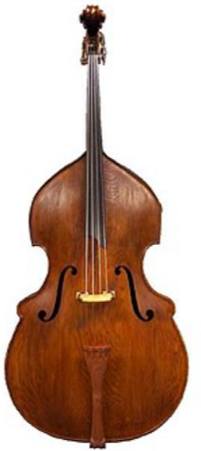
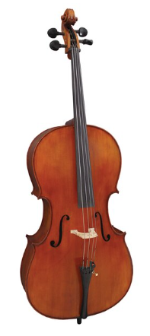
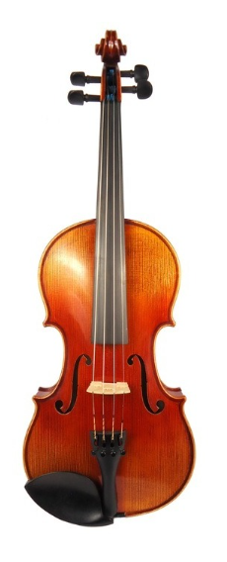
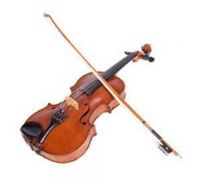
Instrument Groups
Strings - violin, viola, cello and double bass

Slide 6
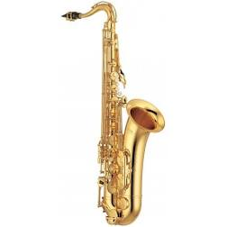
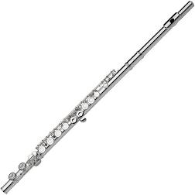
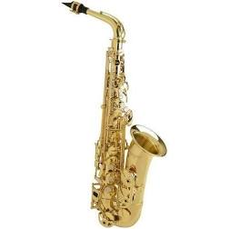
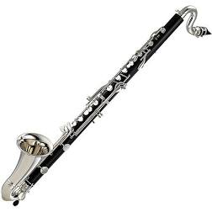
Instrument Groups
Woodwind - flute, clarinet, bass clarinet, alto saxophone and tenor saxophone

Slide 7
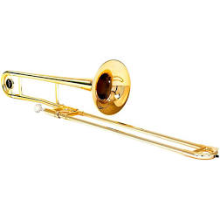
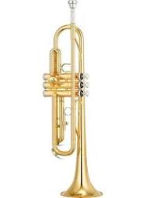
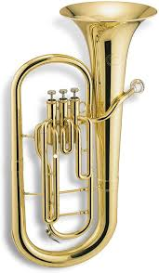
Instrument Groups
Brass - trumpet, french horn, trombone, baritone/euphonium and tuba

Slide 8
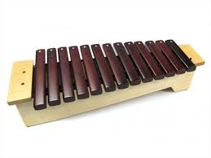
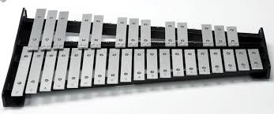
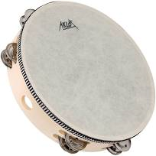
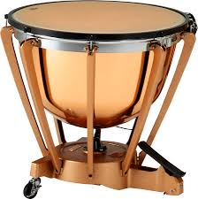
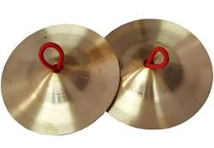
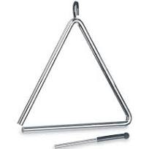
Instrument Groups
Percussion - xylophone, glockenspiel, snare drums, timpani, bass drum and cymbals, triangles and tambourines

Slide 9
Lessons
Students receive a 30 minute Instrumental Music lesson each week.
Students also attend an hour band or strings ensemble rehearsal each week which has compulsory attendance.
Year 4 Band starts in term 2.
Some rehearsals may be scheduled for before school.

Slide 10
Instrumental Fees
All students pay a general Music Resource Contribution of $50. This is used to provide musical scores, entries to competitions etc.
An additional Instrumental Hire Fee is charged to students who have a school loaned instrument. This fee helps cover the cost of maintenance, repairs and eventual replacement of instruments used in the program. It is anticipated the annual fee payable for hire of a school instrument will be $100. (total $150)

Slide 11
Hiring School Instruments
Some school instruments are available for hire. You will be notified if this is the case.
Some are available for the first year of the program only, there after each student is required to provide their own instrument.
Only a few select larger and expensive instruments are hired for either a two or four year duration depending upon the program.

Slide 12
Communication
School E-News: Please ensure that you are registered for the newsletter and read thoroughly the regular notifications and updates.
Emails: This is the most effective means of communicating with the Instrumental Music Teachers, as they have limited days at SHSS and work across several schools in a week. Mrs Carter (Music Co-Ordinator) and Mrs Stoyko (Deputy Principal) may also be of assistance. Please note it is not always possible to respond within 24 hours due to teaching loads and timetables, though we will all endeavour to do our best.
Notes home: Information may be sent home via paper notes. We are moving to a more electronic version of obtaining permission slips where necessary.

Slide 13
EXPECTATIONS: Commitment
Although there is no contract,
it is hoped an expected that
students who learn an instrument
will continue until the end of Year 6.
Three years for the Band Program Yr 4 - 6
Four years for the Strings Program Yr 3 – 6
This ensures balanced ensemble groups.

Slide 14
Value adding
Learning to play an instrument is fun, and something that can be enjoyed for life. It requires dedication, commitment and hard work.
It is also important to recognise that you are part of a TEAM – everyone has an important part to play.
Communication is the key to ensuring that all parties are continuing to enjoy and engage in this special opportunity of being part of the Instrumental Program.

Slide 15
Performances
At the end of term 3, a performance evening is held in the PAC. Limited seating is available with generally, two tickets being issued to the family per child.
Year 4 String and Band Students are required for a very short performance to show-case to new instrumental students for the following year. This is held after school early-term 4.
Other performances as they arise on offer.
On occasions, ensemble groups perform for competitions. You will be advised accordingly.

